Slide 1
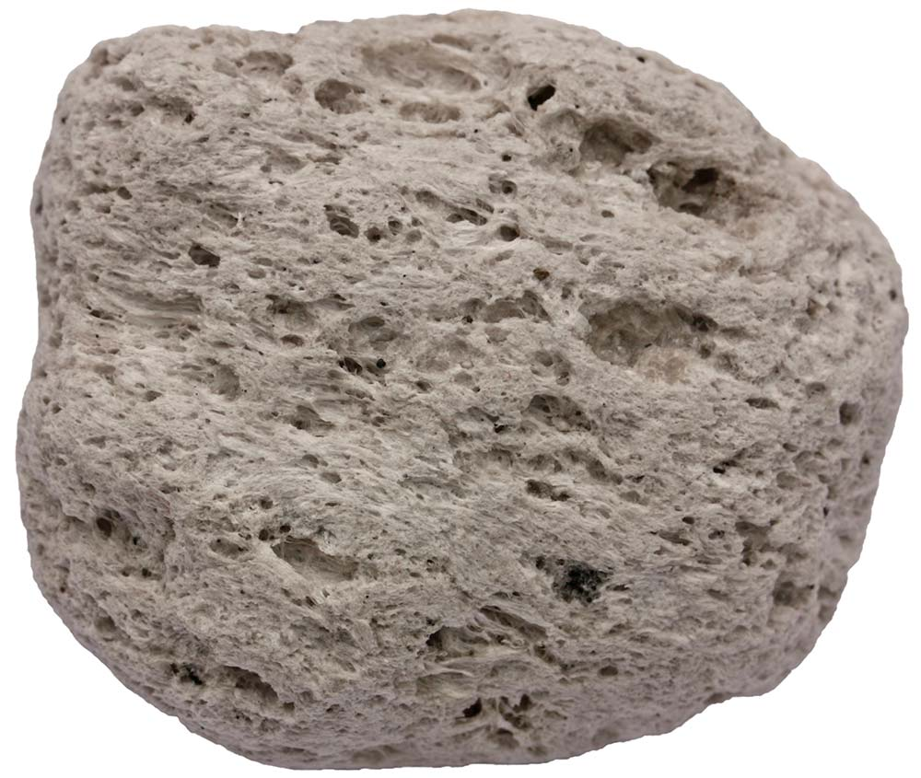
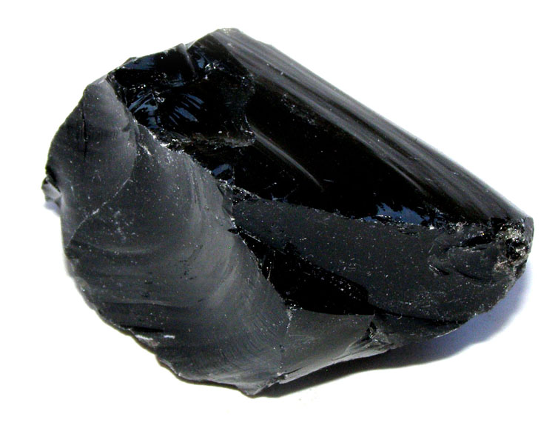
Daily Review
Extrusive Igneous Rocks
Extrusive igneous rocks form on the surface of the Earth
Some igneous rocks have holes formed by volcanic gases escaping from the lava
Pumice and obsidian are both extrusive igneous rocks.
Identify two differences between these rocks.
Which one has been formed from gaseous lava? Explain your answer.
Pumice
Obsidian

Slide 2
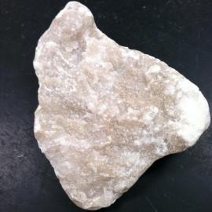
Daily Review
Gypsum is a sedimentary rock that forms in the bottom of lagoons where sea water slowly evaporates.
What type of sedimentary rock is gypsum? Explain your choice.
Sedimentary Rocks
Types of Sedimentary Rocks
Clastic sedimentary rocks are made from rock and mineral grains
Biological sedimentary rocks are made from dead plant or animal material
Chemical sedimentary rocks are made when water evaporates leaving a solid substance behind

Slide 3
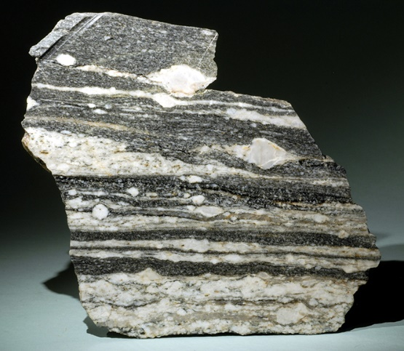
Daily Review
Types of Metamorphic Rocks
Foliated metamorphic have banded layers
Non-foliated metamorphic rocks are uniform in colour
Gniess is a metamorphic rock. Is it foliated metamorphic or non-foliated metamorphic? Explain your choice
Identifying Metamorphic Rocks
1. Uniform colour = non- foliated metamorphic 2. Bands or layers = foliated metamorphic rock

Slide 4
Weathering and Erosion Year 8 Science

Slide 5
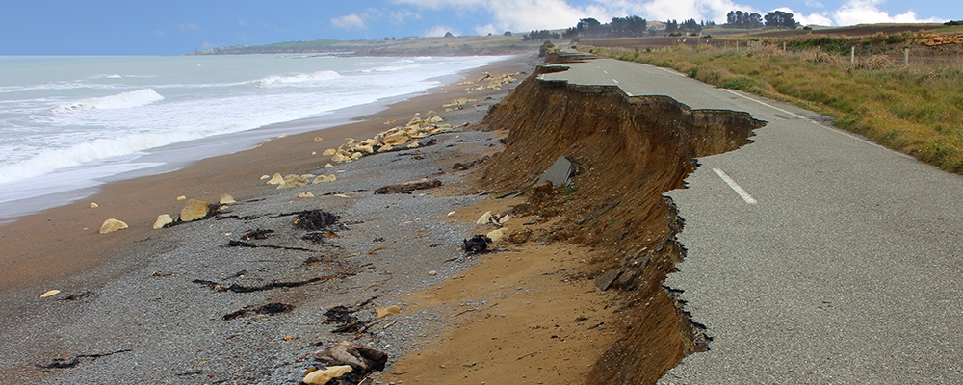
Learning Objective
CFU
What are we going to learn?
Define weathering and erosion
Identify the different types of weathering
Activate Prior Knowledge
Think, Pair, Share: Large storms can cause damage to coastal areas. Explain to the person next to you what you think has happened in the picture below.

Slide 6
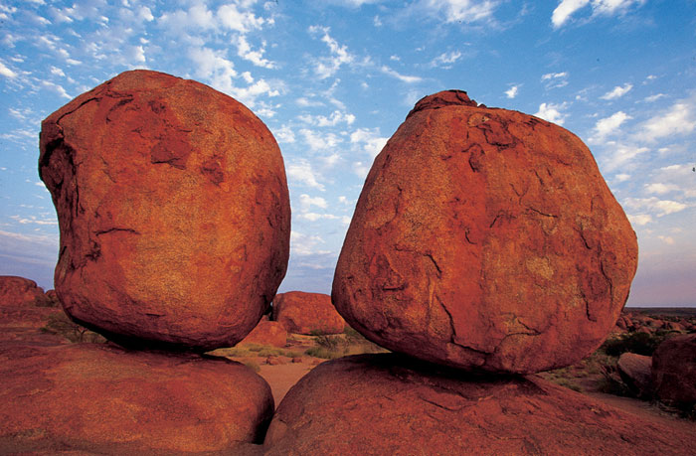
Concept Development
CFU 1
What is weathering?
Weathering is the breaking down of rocks and minerals. Rocks do not last forever because weathering breaks them into smaller pieces.
CFU 2
What causes rocks to break down in physical weathering?
Physical Weathering
Physical weathering occurs when a physical force breaks down a rock.
This force must be produced by non-living things.

Slide 7
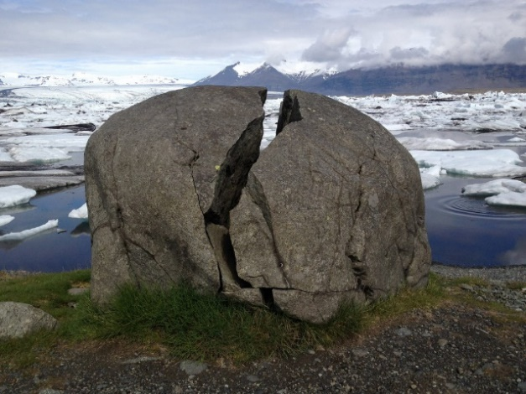
Concept Development
CFU 1
How can physical weathering occur?
Physical Weathering
There are many ways that physical weathering can break down rocks and minerals:
The heating and cooling of rocks can cause the outside layers to peel off
Moving water in oceans or rivers can cause abrasion
Water falling between the cracks in rocks and freezing can cause the cracks within rocks to become larger. Repeated freezing can eventually cause parts of the rock to split off.
CFU 2
How can water cause physical weathering?
CFU 3
Which example of physical weathering would explain the cracks in the rock below?
Vocabulary
weathering the breaking down of a rock or mineral into smaller pieces abrasion scraping or wearing away

Slide 8
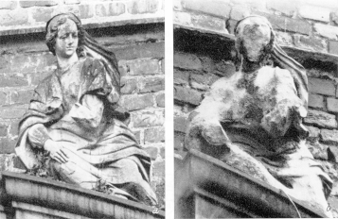
Concept Development
CFU 1
How does chemical weathering occur?
Weathering is the breaking down of rocks and minerals.
CFU 2
How is physical weathering different to chemical weathering?
Chemical Weathering
Chemical weathering changes the minerals in the rocks through chemical reactions.
Carbon dioxide in the air can mix with water in clouds to form a very weak acid.
When the acid rain falls on rocks a chemical reaction occurs and the minerals are washed away.

Slide 9
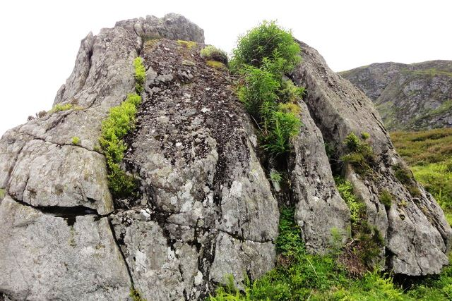
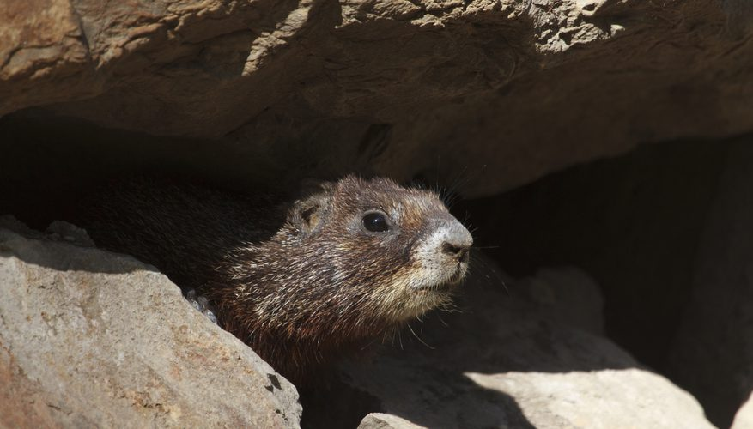
Concept Development
CFU 1
How is biological weathering different to physical weathering?
Weathering is the breaking down of rocks and minerals
CFU 2
A seed blows into a crack in a rock. As it grows the crack in the rock gets bigger. Is this biological weathering? Explain why or why not.
Biological weathering
Biological weathering occurs when living things break down rocks (e.g. tree roots, rabbit burrows, microbes).
Vocabulary
microbe a microscopic organism such as a bacterium

Slide 10
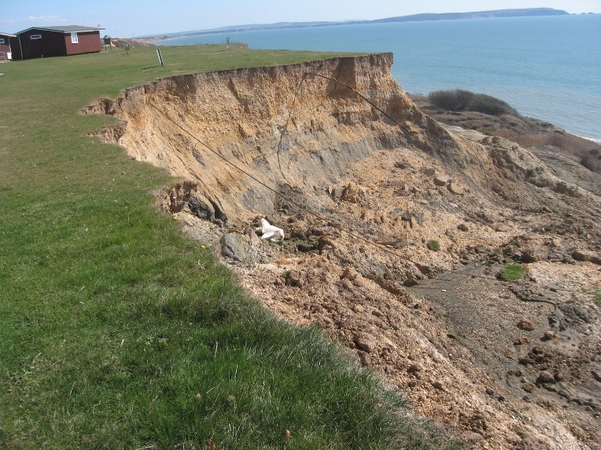
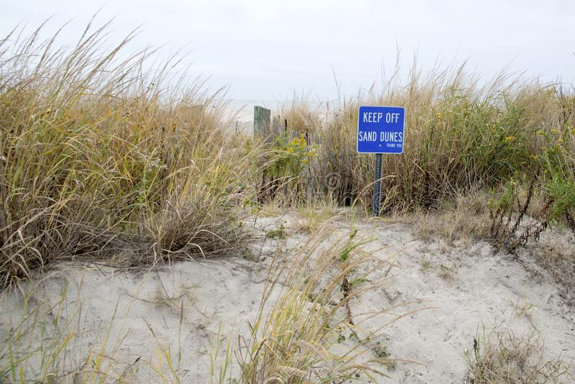
Concept Development
CFU 1
What is erosion?
Erosion
Erosion is the movement of sediment from one area to another.
Small particles of rocks that have been broken down by weathering are carried away by water, wind and ice.
CFU 2
How is erosion different to weathering?
CFU 3
When walking to beach through the sand dunes it is recommended that you stick to the path. Why must we do this?
Vocabulary
sediment small rock particles

Slide 11
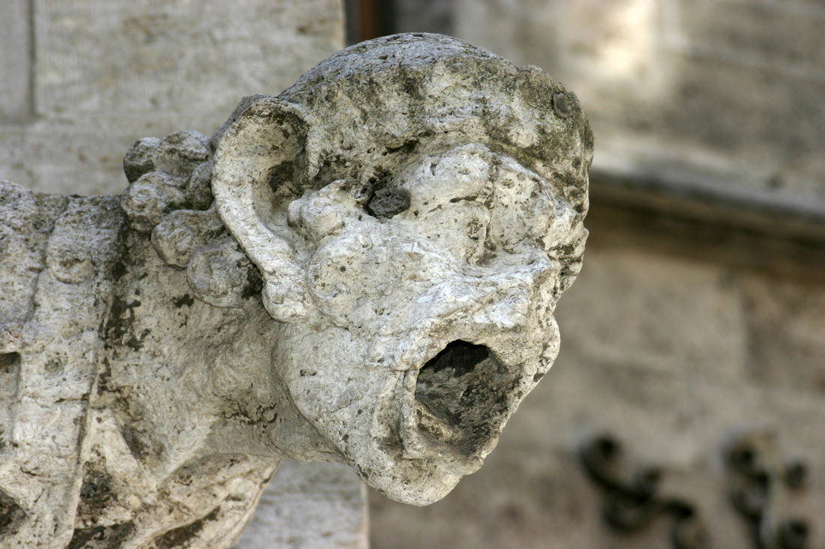
Skill Development / Guided Practice
CFU 1
Is the weathering caused by living things?
Identifying Types of Weathering
1. The weathering is caused by a living thing = biological weathering 2. The weathering is caused by a non-living thing Chemical reactions cause weathering = chemical weathering Physical forces cause weathering = physical weathering
CFU 2
Are there chemicals causing the weathering?
CFU 3
What type of weathering has occurred?
All this rain is wearing me down…
The statue is breaking down due to chemical weathering. A weak acid rain has caused the limestone to break down.
Vocabulary
weathering the breaking down of a rock or mineral into smaller pieces

Slide 12
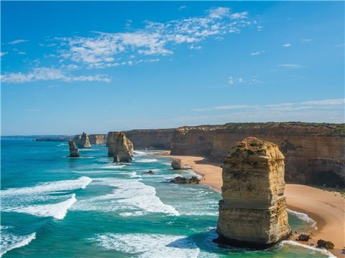
Skill Development / Guided Practice
CFU 1
Is the weathering caused by living things?
Identifying Types of Weathering
1. The weathering is caused by a living thing = biological weathering 2. The weathering is caused by a non-living thing Chemical reactions cause weathering = chemical weathering Physical forces cause weathering = physical weathering
CFU 2
Are there chemicals causing the weathering?
CFU 3
What type of weathering has occurred?
Fun fact: the 12 Apostles are famous limestone pillars found off the coast of Victoria. Only 8 remain!
These rocks are being broken down through physical weathering. The ocean is causing the rocks to break down into smaller pieces.
Vocabulary
weathering the breaking down of a rock or mineral into smaller pieces

Slide 13
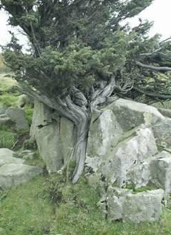
Skill Development / Guided Practice
CFU 1
Is the weathering caused by living things?
Identifying Types of Weathering
1. The weathering is caused by a living thing = biological weathering 2. The weathering is caused by a non-living thing Chemical reactions cause weathering = chemical weathering Physical forces cause weathering = physical weathering
CFU 2
Are there chemicals causing the weathering?
CFU 3
What type of weathering has occurred?
This rock has been broken down through biological weathering. A tree is growing and the roots are causing the rock to crack.
Vocabulary
weathering the breaking down of a rock or mineral into smaller pieces

Slide 14
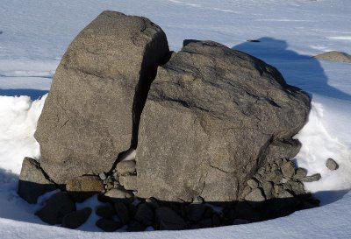
Skill Development / Guided Practice
CFU 1
Is the weathering caused by living things?
Identifying Types of Weathering
1. The weathering is caused by a living thing = biological weathering 2. The weathering is caused by a non-living thing Chemical reactions cause weathering = chemical weathering Physical forces cause weathering = physical weathering
CFU 2
Are there chemicals causing the weathering?
CFU 3
What type of weathering has occurred?
Vocabulary
weathering the breaking down of a rock or mineral into smaller pieces

Slide 15
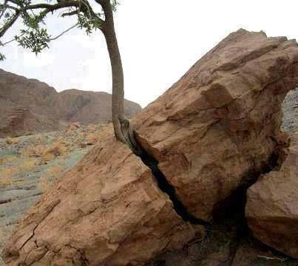
Skill Development / Guided Practice
CFU 1
Is the weathering caused by living things?
Identifying Types of Weathering
1. The weathering is caused by a living thing = biological weathering 2. The weathering is caused by a non-living thing Chemical reactions cause weathering = chemical weathering Physical forces cause weathering = physical weathering
CFU 2
Are there chemicals causing the weathering?
CFU 3
What type of weathering has occurred?
Vocabulary
weathering the breaking down of a rock or mineral into smaller pieces

Slide 16
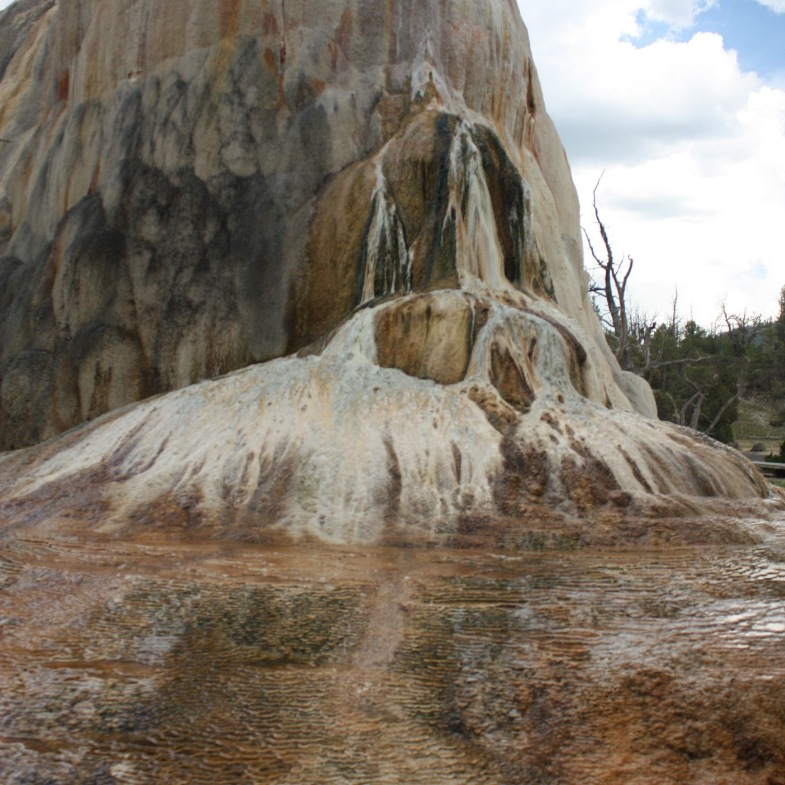
Skill Development / Guided Practice
CFU 1
Is the weathering caused by living things?
Identifying Types of Weathering
1. The weathering is caused by a living thing = biological weathering 2. The weathering is caused by a non-living thing Chemical reactions cause weathering = chemical weathering Physical forces cause weathering = physical weathering
CFU 2
Are there chemicals causing the weathering?
CFU 3
What type of weathering has occurred?
Vocabulary
weathering the breaking down of a rock or mineral into smaller pieces
Notes:
This is CHEMICAL Weathering. Different components of the rock are weathered to different extents over time.

Slide 17
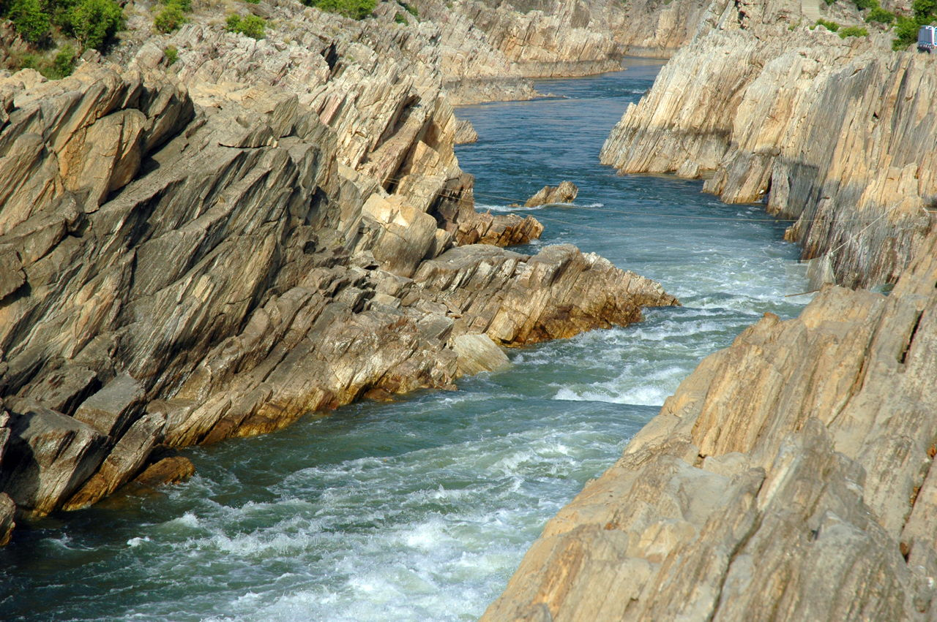
Skill Development / Guided Practice
CFU 1
Is the weathering caused by living things?
Identifying Types of Weathering
1. The weathering is caused by a living thing = biological weathering 2. The weathering is caused by a non-living thing Chemical reactions cause weathering = chemical weathering Physical forces cause weathering = physical weathering
CFU 2
Are there chemicals causing the weathering?
CFU 3
What type of weathering has occurred?
Vocabulary
weathering the breaking down of a rock or mineral into smaller pieces

Slide 18
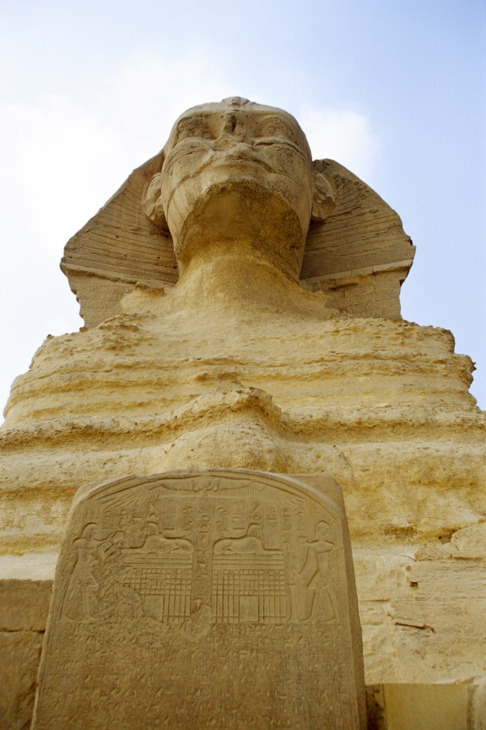
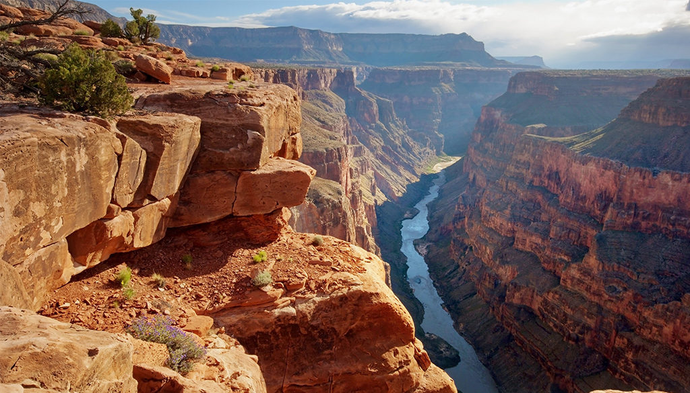
Relevance
Understanding the impact weathering has on rocks can affect their use, or how they need to be protected.
Understanding the different types of weathering can help to explain the formation of natural landmarks.

Slide 19
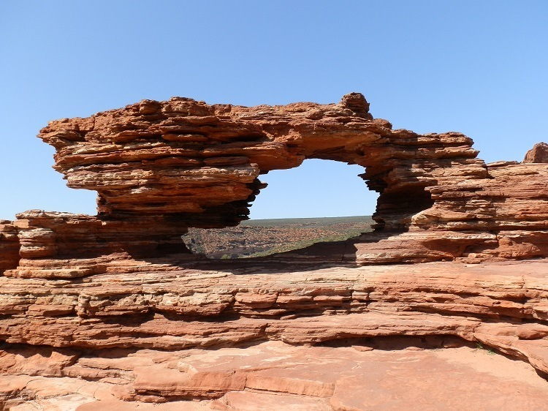
Skill Closure
Explain the difference between weathering and erosion.
Skill Closure
Nature’s Window in Kalbarri was formed in ancient times by waves moving around in shallow seas. What type of weathering is this? Explain your choice.
Skill Closure
When hilly areas are excavated, workers sometimes cover the ground with a spray on paper like material. Why might they do this?

Slide 20
Independent Practice
Complete the table below in your book or on your device.
 | Definition | Example | Diagram
Physical Weathering
Chemical Weathering
Biological Weathering
Erosion
Challenge: Find an area in WA that has been affected by erosion. Suggest a way further erosion could be prevented.
(Hint: Look at page 33 in the textbook.)

